Slide 1
SYSTEM INFORMATION THE CALDERA TOBA SIBISA
By : GROUP 09 PA-II DIV-TRPL

Slide 2
OUR TEAM
YUDI FRANDIANTO SARAGIH
11421018
GUNAWAN SINAGA
11421032
TRIVERA SILALAHI
11421046
ANITA LUCIANA MUNTHE
11421048
SILVANY PUTRI SIPAHUTAR
11421056

Slide 3
Table of contents
01
02
03
04
03
04
05
06
Introduction
Background
System Overview
Usecase
ERD
Function
Demo

Slide 4
INTRODUCTION
To complete the Final Year II Project
Providing complete information to meet the public’s need to seek information
Improve skills and creativity

Slide 5
BACKGROUND
Difficulty in finding information about the Toba Sibisa Caldera
Lack of promotional media for Caldera Toba Sibisa

Slide 6
System Overview
Current System
Target System

Slide 7
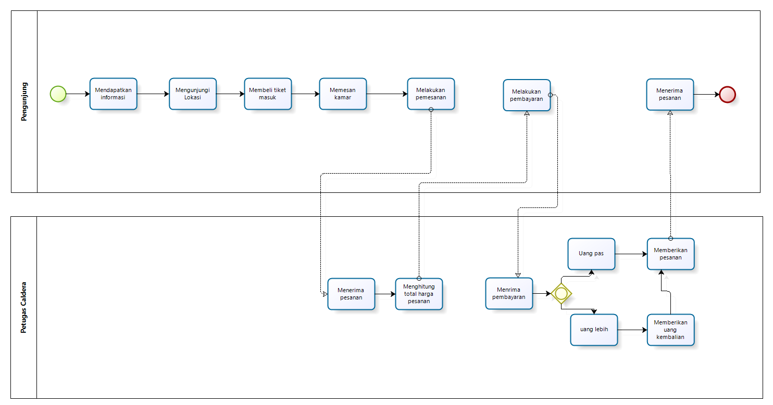
Current System

Slide 8
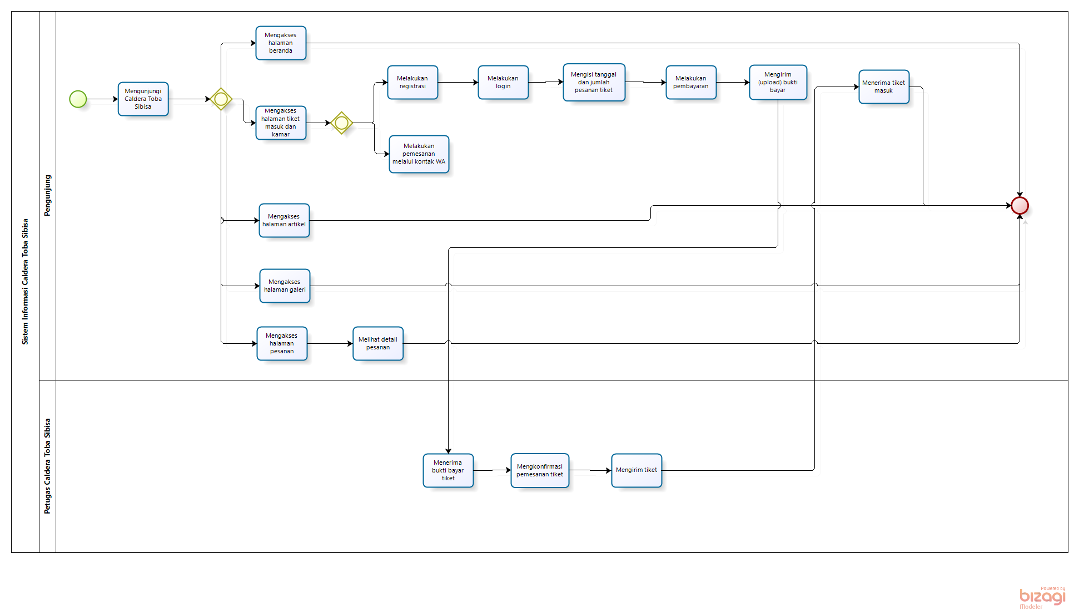
Target System

Slide 9
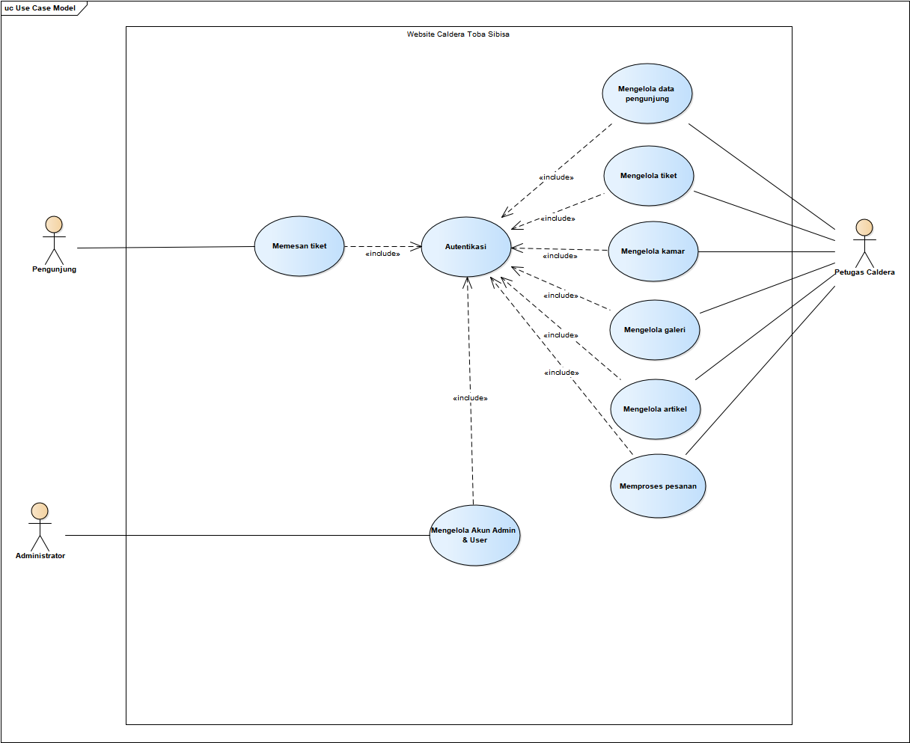
USE CASE DIAGRAM

Slide 10
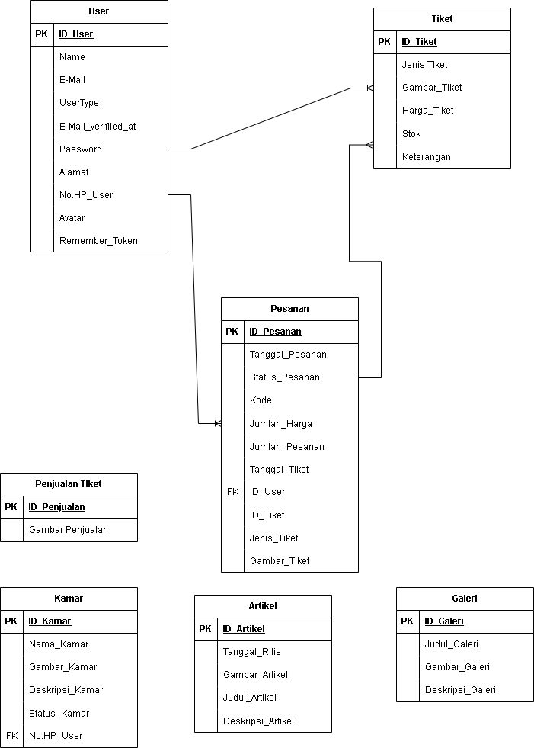
ERD

Slide 11
FUNCTION
Book Tickets
Manage Tickets
Managing Rooms
Managing Galleries
Managing Articles
Manage Visitor Data
Process Orders
Authentication

Slide 12
DEMO

Slide 13
Thank You

